Slide 1
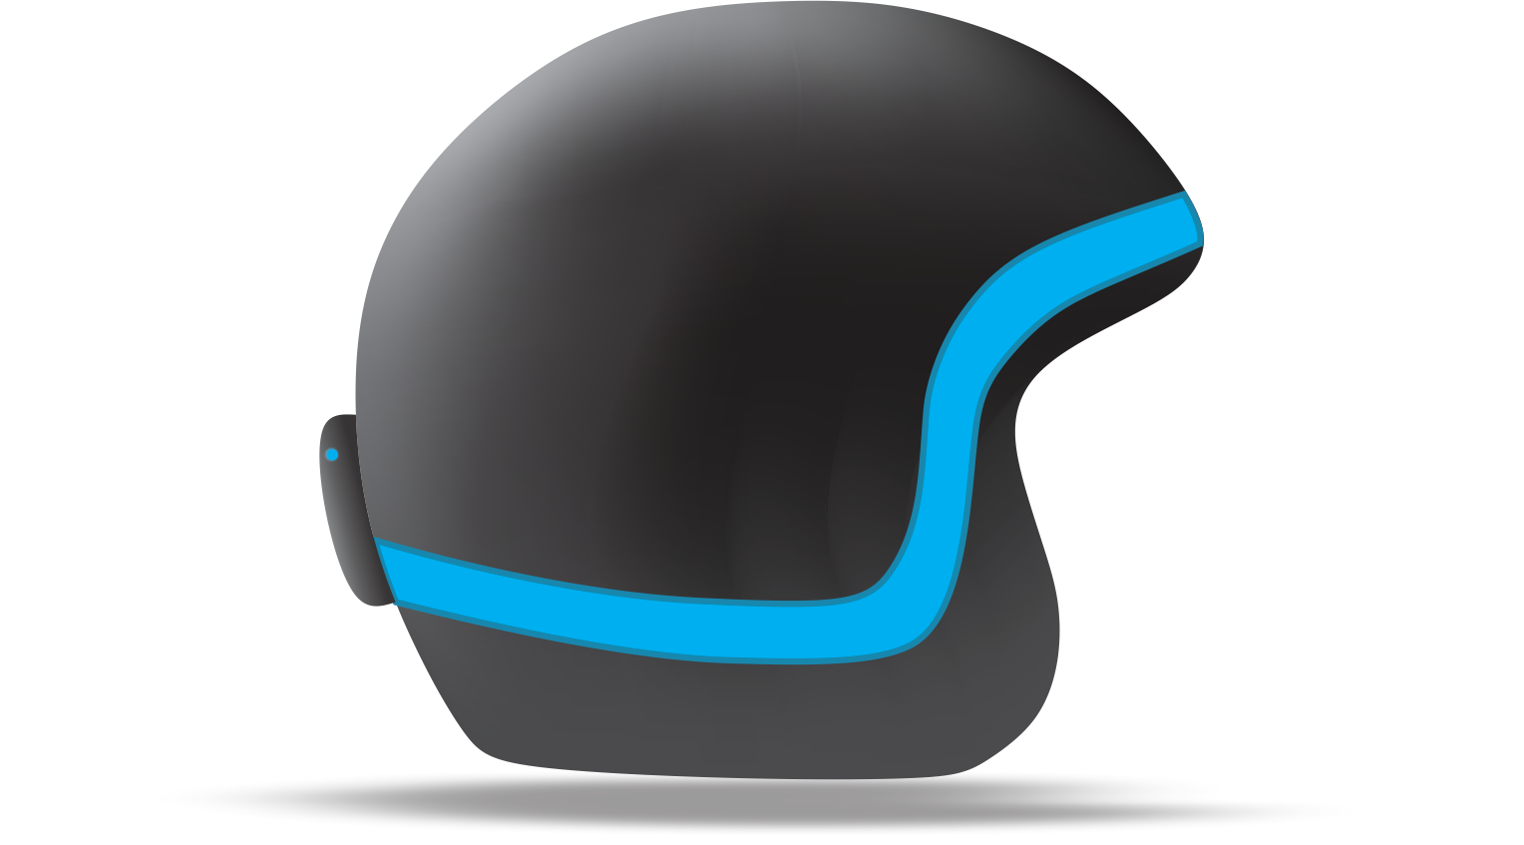
SMART HELMET : IoT BASED
A Safer Way To RIDE
TEAM: CODE SPEAR

Slide 2

SMART HELMET
A Safer Way To RIDE
THE ISSUE
STATS
SOLUTION
Our issue is that people don’t consider helmet as an important part of the ride, they risk their life due to carelessness.
Per year around 39,975 deaths occur due to not wearing helmet and around 36,678 seriously injured.
Our solution simply make sure that every rider wear helmet and ride safer.

Slide 3
SMART HELMET
A Safer Way To RIDE
Our Idea is based on client-server model.
SMART HELMET functioning is simple, it consists of two modules:
One of the module will be installed in motor vehicle.
The other one will be installed in the helmet.
Both of these modules would be connected via Wi-Fi.
These two modules will work as a single system and will make ensure that the motorbike won’t function unless the rider wear helmet.

Slide 4

SMART HELMET
A Safer Way To RIDE
ANNIMATION

Slide 5
SMART HELMET
A Safer Way To RIDE
SERVER
Server model will be installed in the bike and it consists of following parts:
NodeMCU
OLED
Relay
The server module controls the bike using a relay and it triggers the relay when it receives instructions from the client.

Slide 6
SMART HELMET
A Safer Way To RIDE
CLIENT
Client model will be installed in the helmet and it consists of following parts:
Capacitive Touch Sensor
NodeMCU
Buzzer
The client module detects whether the rider is wearing helmet or not using a capacitive touch sensor and connects with the server on successful recognition and pass the instruction to the server.

Slide 7
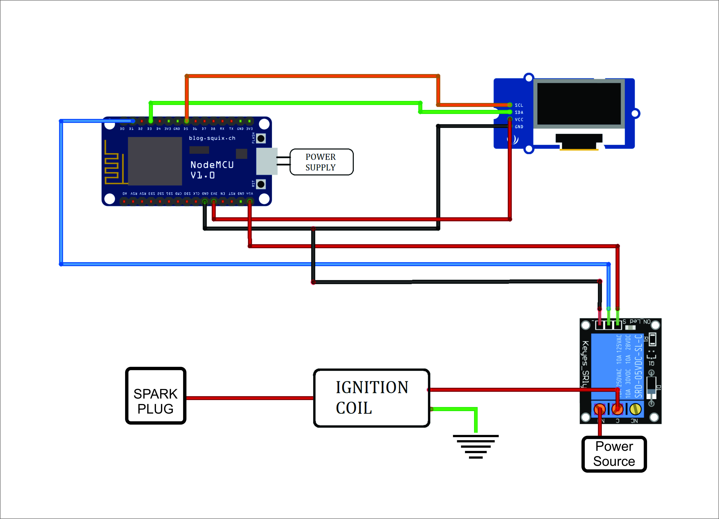
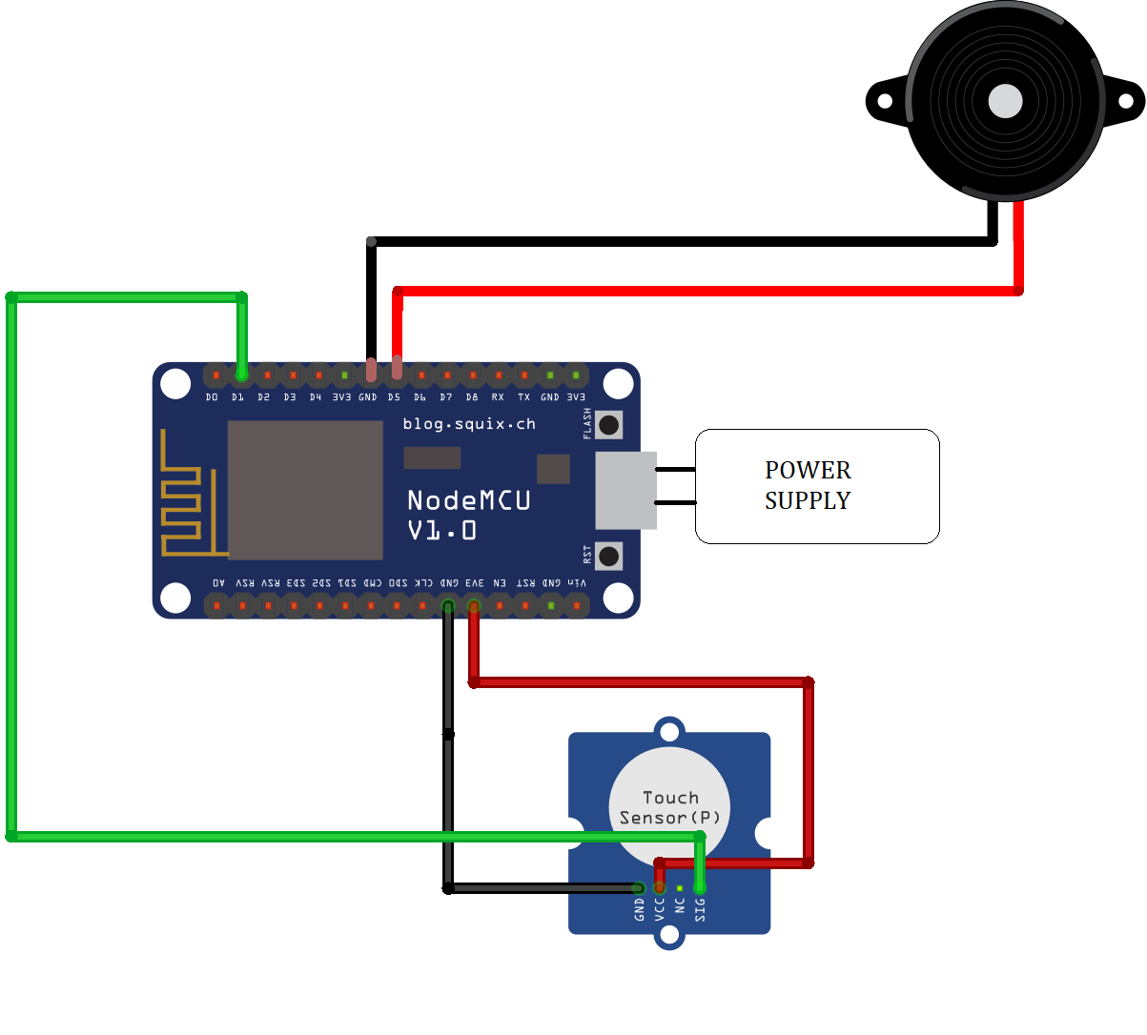
SMART HELMET
A Safer Way To RIDE
SERVER
CLIENT

Slide 8
SMART HELMET
A Safer Way To RIDE
NodeMCU:
It is a micro controller which is used to implement client-server communication.
OLED:
It is used to display the connectivity status of modules and messages.
Capacitive Touch Sensor:
It is used to ensure that the helmet is worn by none other than a human being.
Relay:
It is installed with the ignition coil and it is used to control motor vehicle functioning

Slide 9
SMART HELMET
A Safer Way To RIDE
Advantages
NodeMCU [ESP8266] make the system robust as it uses 2 level security
Our system is feasible so it is accessible for everyone
We are using latest technologies like NodeMCU and OLED display
Our system can be installed in every two-wheeler
Our system has a wide range of future advancements including license detection and accidental
detection etc.

Slide 10
SMART HELMET
A Safer Way To RIDE
THANK YOU
ANY QUESTIONS?

